Slide 1
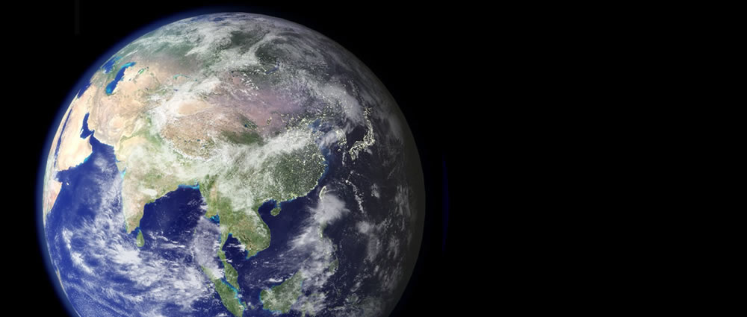
Earth Day Challenge
April 22th
Delphos Project

Slide 2
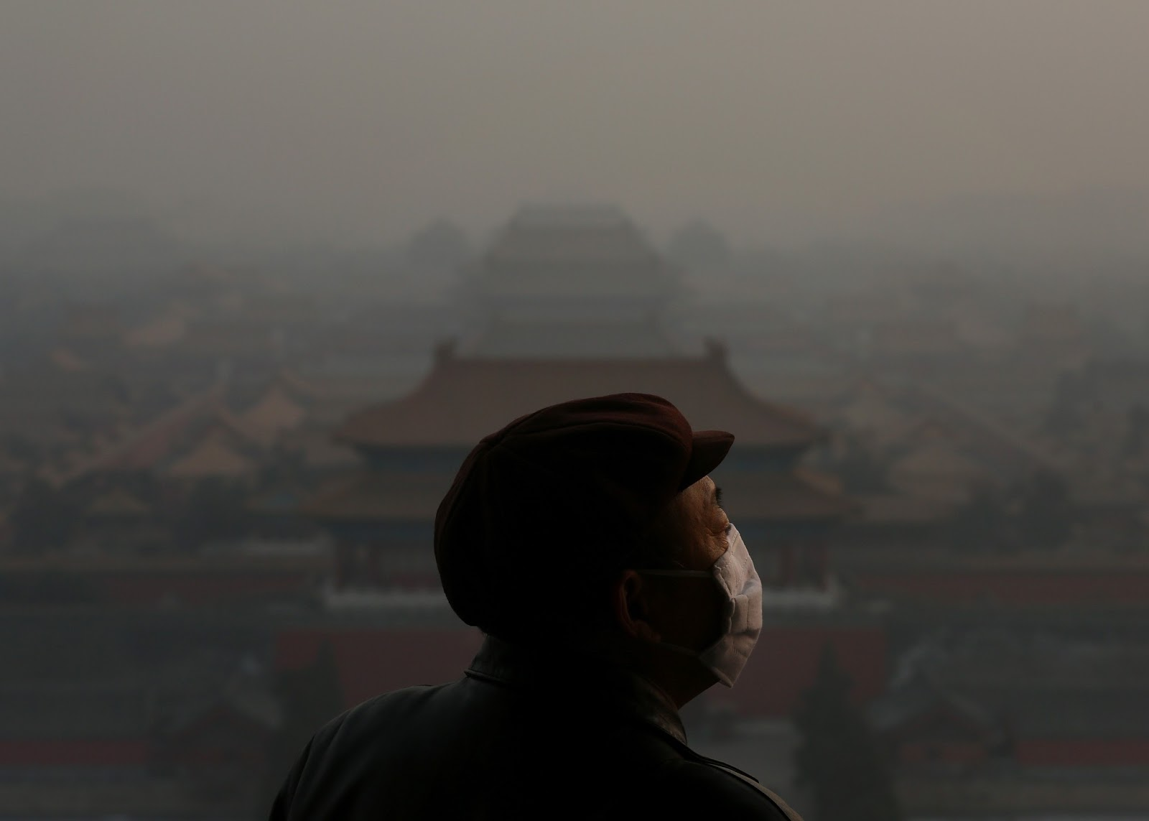
Why?

Slide 3
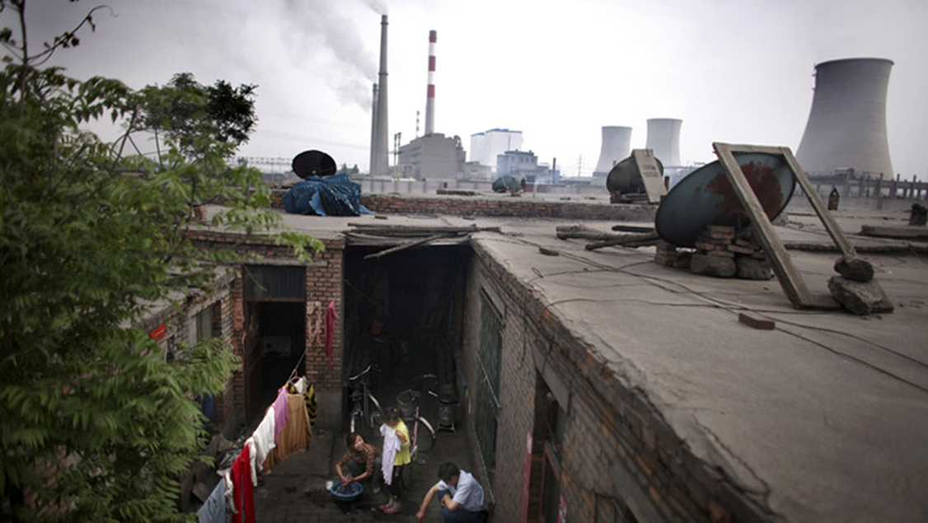
PM10

Slide 4
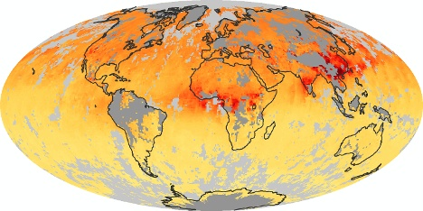

Slide 5
